Slide 1
Module Agenda
Data Centers (cont. from last week)
Virtualization
Storage Approaches
Cloud Computing
Intro and Assignments
Cloud Paradigms
Cloud Models
IT as a Service

Slide 2
Virtualization: The Foundation for a Greener Datacenter
Today: 70 million virtual desktops

Slide 3
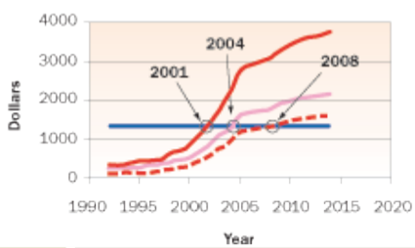
Market Perspective
kW per Rack
Datacenters becoming exponentially more dense
Datacenter refresh driven by power/cooling/space
Energy cost is consuming more budget and is harder to ignore
The divide between IT and facilities is narrowing
Environmental impact, govt awareness and corporate initiatives on the rise
Cost to Power Server Will Soon Exceed Purchase Price
Notes:
In terms of what's happening in the market, the first thing is that datacenters are becoming a lot more dense. The kilowatts per rack has gone up quite dramatically in recent years and the trend is continuing. As you move to blade servers, you have more dense form factors that consume more power. One customer, an executive, went down to the datacenter because he heard from his IT department that it was full. But, it turns out, the datacenter is only half physically full (from a facility and space standpoint), but has no more electrical power.
This risk of customers running out of power in the datacenter is real. In fact, Gartner said that 50% of companies would face this situation by this year. Many companies are making a datacenter refresh decision based solely on power/ cooling and space considerations.
In terms of energy, the first thing you hear today from customers is about reducing costs. Traditionally, we've been able to ignore costs on energy for some time because Facilities was paying the bill (IT wasn't accountable for the energy bill). But in the next couple of years, this is going to change. There's going to be accountability, and as a result, there will be a more holistic view of the costs of deploying a new application. This will include calculating in the facilities cost, which can be four or five times the cost of the IT infrastructure.
Recently, there's a lot more awareness of what's happening in the datacenter from an environmental perspective. Governments are starting to get involved in the regulation of carbon emissions and so there's a big risk that companies, if they don't do this proactively, will be forced to do it.
Perhaps more interestingly, there's an opportunity to leverage a Green Datacenter for differentiation purposes. Companies that proactively do this not only reap financial advantages, but also corporate goodwill, as responsible and progressive companies that will attract the best talent available.

Slide 4
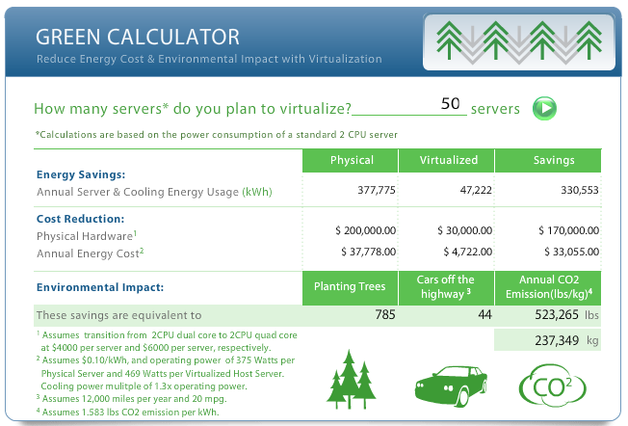
Cost Savings Potential
“Power consumption per server in a data center was recently reported to have passed the cost of the server itself during its lifetime – typically three years. Data centers consume 1.2 percent of global power – 2 percent in the U.S. – and there are only approximately 13,000 of them. The number of data centers being built around the world is expected to double by 2016.”
http://www.triplepundit.com/2013/02/sustainable-data-center-future/

Slide 5
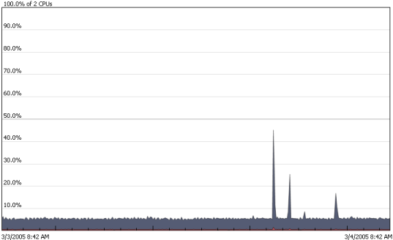
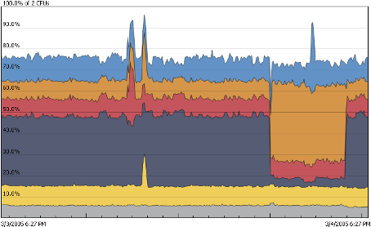

Consolidating Server, Storage, Network & Facilities
VMware consolidates servers, storage and networking infrastructure to safely achieve higher utilization
BEFORE VMware
AFTER VMware
Servers
Storage
Network
Facilities
1,000
Direct attach
3000 cables/ports
200 racks
400 power whips
Planning expansion
80
Tiered SAN and NAS
300 cables/ports
10 racks
20 power whip
Defer/avoid $1k per sqft expansion cost
Source: Actual customer data
http://www.slideshare.net/datacenters/vm-ware
Notes:
5
Let’s look at a real life customer example:
In 2003, the IT service arm of a leading North American energy company started a consolidation project, using VMware Infrastructure as the primary vehicle for achieving this.
The customer had 1000+ x86 industry standard servers,
- >100 SQL servers
- Lotus notes mail servers
- Citrix servers
- Lots of Line of Business applications
Using VMware as the primary system infrastructure strategy capability, they ended with 80, 8-socket capable IBM x440 servers, a 12 to 1 reduction.
What is interesting is how consolidation has affected their infrastructure beyond the reduced server count.
Virtualization based consolidation not only affects the servers that are consolidated, but raises the quality and service levels of everything around it, including storage, network and facilities. Specifically in this project.
Consolidation of Storage: moved from silo’d direct attached storage to highly available Tiered Storage, specifically a Hitachi SAN
A 10:1 consolidation of network ports, or in the words of the customer “from spaghetti wiring to world class datacenter.”
Dramatic power savings and cost avoidance on the facilities and hardware infrastructure.
The main point is at the bottom: the real estate piece. In the U.S. the average cost of building out new space is $1,000 per square foot. So these can be hundreds of millions of dollars that you're spending in new space. The value of deferring or altogether avoiding that expense garners executive attention. It is a real and tangible savings.

Slide 6
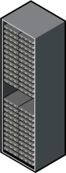


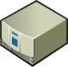
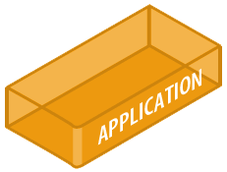

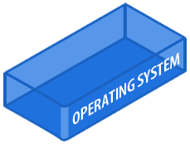
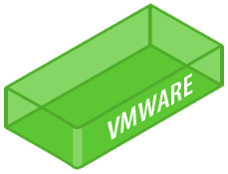
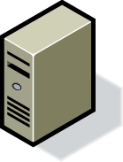
Right-Size IT Infrastructure
Consolidate…
…entire farms of servers and storage…
HW
HW
HW
HW
HW
HW
…and dynamically optimize to only consume the resources you need!
HW
HW
HW
HW
HW
HW
HW
HW
HW
HW
HW
HW
http://www.slideshare.net/datacenters/vm-ware
Notes:
Your IT server load is dynamic. It's always changing based on market or corporate situations, whether through acquisition or growth.
As a result, it's really about continuous right-sizing IT infrastructure, server, storage and networking. We're doing this across the datacenter and doing it in real time. We want to dynamically match the compute requirements to the energy supply. You only want to be using as much energy as you need to meet service levels that your business and your users require.

Slide 7
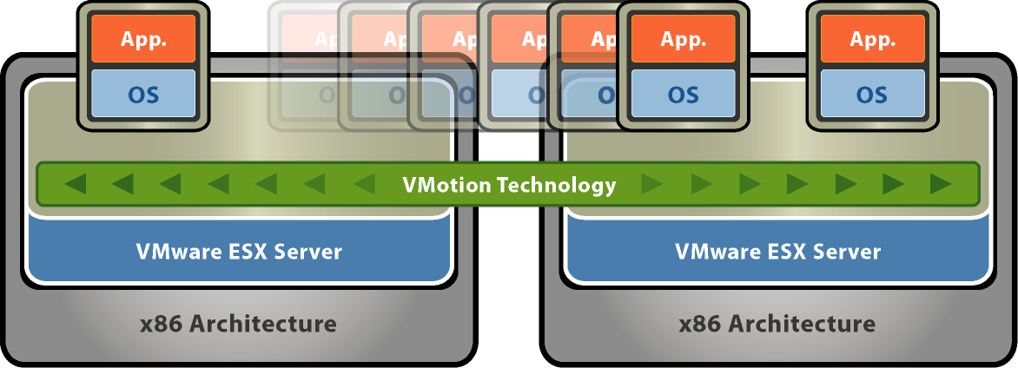
Let’s you move live, running virtual machines from one host to another while maintaining continuous service availability.
http://www.slideshare.net/datacenters/vm-ware

Slide 8
Storage approaches

Slide 9
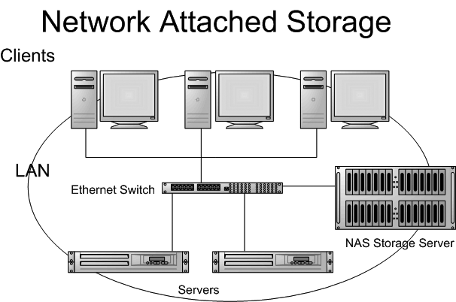
Network Attached Storage
Server with lots of HD space
Uses existing network infrastructure

Slide 10
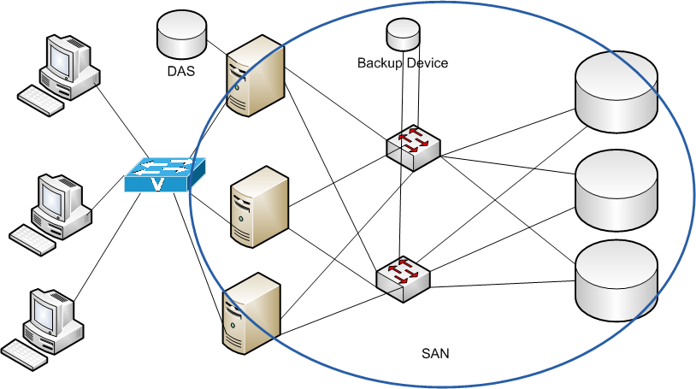
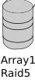
Storage Area Network
Windows
Linux
Unix
Fiber channel

Slide 11
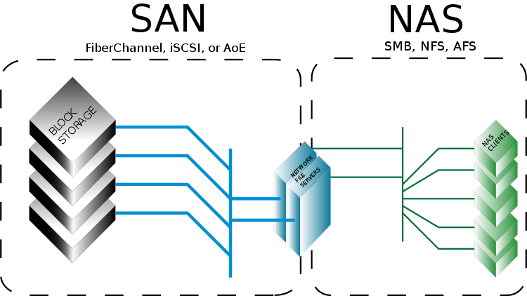
SAN vs NAS
Notes:
NAS vs SAN
NAS provides both storage and a file system. This is often contrasted with SAN (Storage Area Network), which provides only block-based storage and leaves file system concerns on the "client" side. SAN protocols are SCSI, Fibre Channel, iSCSI, ATA over Ethernet (AoE), or HyperSCSI.
Despite their differences, SAN and NAS are not mutually exclusive, and may be combined as a SAN-NAS hybrid, offering both file-level protocols (NAS) and block-level protocols (SAN) from the same system. An example of this is Openfiler, a free software product running on Linux based systems.

Slide 12
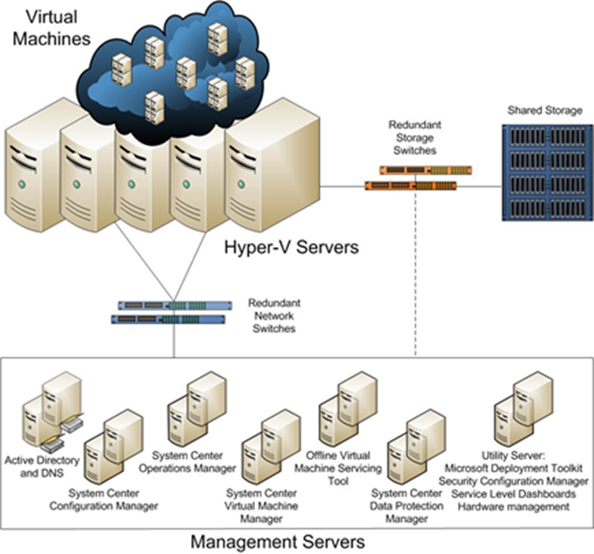
Data Center Storage

Slide 13
Client VDI

Slide 14
Additional VDI Background
Persistent
Each user gets their own image
User settings saved, personalizable, more readily accepted
Requires substantially more storage and image management
Non-persistent (golden image)
One image per user group, fresh every time
No personalization
Requires much less storage and image management, more secure
Notes:
With one-to-one persistent VDI, each desktop runs from a separate disk image. The user's settings are saved and appear each time at login. These types of desktops allow for more personalization, but they require more storage and backup than nonpersistent desktops.
Advantages: Customization and familiarity
Cons: Storage requirements and image management
When users access a nonpersistent desktop, none of their settings or data is saved once they log out. At the end of a session, the desktop reverts back to its original state and the user receives a fresh image the next time he logs in.
Advantages: Image manageability, greater security, less storage
Cons: Less personalization, application flexibility

Slide 15
Client side
Thick client
Goes well with persistent images
User can work even if there is no network available
Less benefits, runs thin client software to create VDI
Thin client
Not much processing capability, goes well with non-persistent images
Requires access to network to get work done
Less expensive, centralized management
Zero client
Even less processing capability (essentially a monitor with keyboard, pointing device and a NIC)
Less expensive still, proprietary

Slide 16
VDI vs DaaS
Same types of benefits
Simplified desktop management, less hardware, increased flexibility, data control
DaaS requires not just network access but Internet access to work
PROS - doesn’t require the backend servers and virtualization (managed by the provider– servers, resource provisioning, load balancing)
Good possible solution if you have no virtualization experience
CONS - trust/security – lack of control, connectivity, reliability, who owns the data stored at the provider sites? (and where are those sites anyway?)
Notes:
DaaS -Desktop as a Service

Slide 17

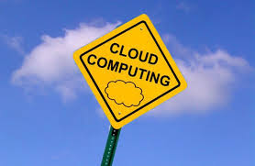
Cloud Computing – An Overview

Slide 18
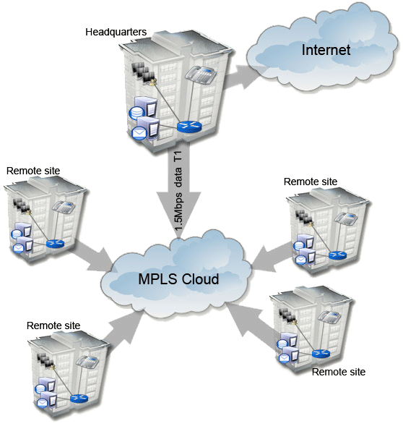
Memo 2 Feedback
Lots of options here
I would (after careful traffic analysis) probably recommend something like:
HQ and Regions plugged into an MPLS Cloud with a vendor like AT&T or Century Link
Connect Stores to Regions with business class cable and site to site VPN
I would off load the ecommerce site to a hosting vendor (no real expertise at TRU) running from a duplicated inventory db

Slide 19
Evolution of computing paradigms

Slide 20
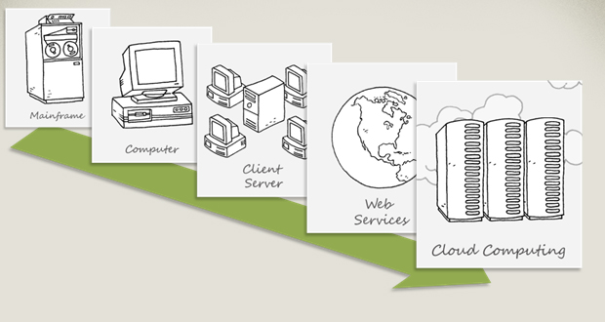
Evolution of computing paradigms

Slide 21
+
Highly Centralized Very Powerful
–
Programmer Productivity
1960s
Mainframes ruled the earth.
framework
Low level & Sequential (Assembly, COBOL, ForTran)

Slide 22
Mainframes +/-
Advantages
Disadvantages
Very large in both size and scientific computing capability
designed to handle mission critical data
built-in security features
handle high level data transactions
24x7x365 ability
Long lasting performance
Banks loved them!
Installations were more complicated to set up
Costly
Special operating systems/software
Power usage, heat
high-end skilled workers needed
Banks still love them!

Slide 23
+
Programmer Productivity
–
Less Powerful More Administration
1970s
The rise of the Minis
framework
Structured (Pascal, C)

Slide 24
Minis +/-
Advantages
Disadvantages
sold for much less than mainframe
capable of running programs in a higher level language
designed for control
Designed for human interaction & communication rather than calculations
high processing power and capacity
Used in manufacturing process control, telephone switching etc
Inflexible
Less powerful
Market introduced lower cost of microprocessor-based hardware
the emergence of inexpensive and easily deployable PCs and local area network systems

Slide 25
+
Programmer Productivity Surge in Demand
– Even Less Power Increased Administration
1980s
Proliferation of the PCs
framework
Object Oriented Programming (C++)
protocol
Network (Socket) programming

Slide 26
PCs +/-
Advantages
Disadvantages
inexpensive and sold for much less than minis
small
easier to operate
easily customized to fit individual needs
PCs cannot be used by many users simultaneously
PC’s (were) limited to only one processor
Less powerful than mainframes (at that time) so heavy computing (financial and scientific) could not be done
not as sturdy as mainframes and thus shorter lifespans

Slide 27
+
More Centralized More Powerful
–
Administration Explosion
1990s
Network the Servers
framework
Component Oriented Programming (COM)
protocol
Homogeneous Client-Server, RPC Based (DCOM, CORBA, RMI)

Slide 28
Networks +/-
Advantages
Disadvantages
lower costs
centralized
file sharing
device and resources can be shared
increased communication capabilities
avoid file duplication and corruption
distributed data processing
increased storage capacity
security and vulnerability
dependency on file server
expensive set up
easy spread of viruses
complex management requiring training

Slide 29
+
Centralized Applications Lower Administration
Rise of Mobile platform
–
Lack of Customization Lack of Multi-Tenancy
2000s
The Internet comes of age
framework
Component Oriented Programming (.NET)
protocol
Heterogeneous 3/n-Tier, Message Passing based Web Computing (Web Services, SaaS)

Slide 30
Internet +/-
Advantages
Disadvantages
faster communication
vast quantities of information at your finger tips
global reach
cheap and convenient to use
entertainment
electronic mail
social (virtual) communication
e-commerce
Shopping !
unsecure
information is unreliable
susceptible to hacking
spam
viruses
expensive set up
theft of personal information
WWW- Wild Wild West!

Slide 31
+
–
2010s
Welcome to the Cloud
framework
Service Oriented Architecture (.NET, WCF)
protocol
Web Computing, Cloud Computing (Web Services – WS*, SOAP, REST)
Notes:
SOAP – Simple Object Access Protocol – used for exchanging structured information, relies on XML. Forms the foundation of Web Services protocol stack
REST – representative state transfer – a lighter version of SOAP, invokes web services over HTML.

Slide 32

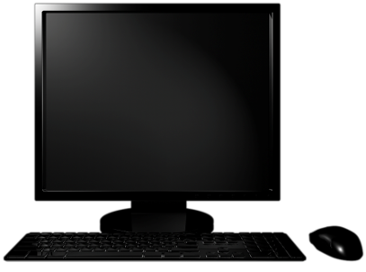
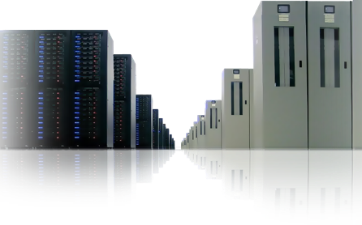
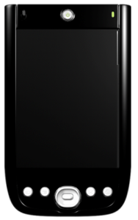
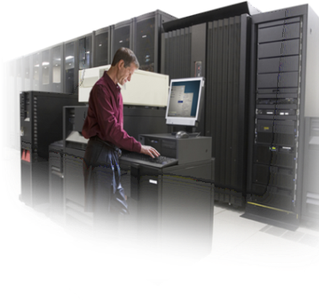
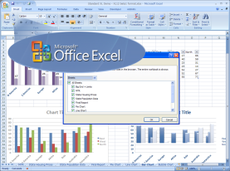
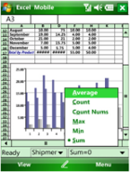

Platform Evolution
Hosted software platform
Shared infrastructure
Virtualized and dynamic
Client
Server
Mobile
Cloud
Increasingly higher level services
Pay as you go pricing model

Slide 33
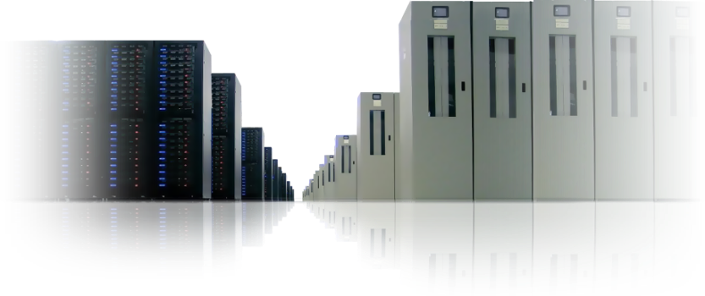
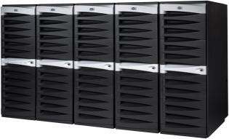


Platform Continuum
On-Premises
Servers
Hosted Servers
Cloud Platform

Slide 34
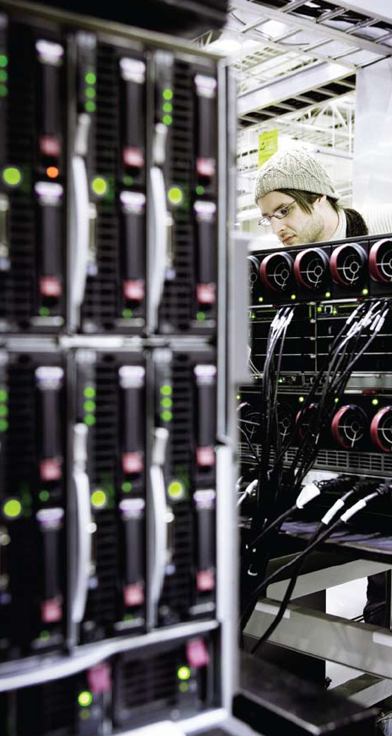
On-Premise
Bring your own machines, connectivity, software, etc.
Complete control
Complete responsibility
Static capabilities
Upfront capital costs for the infrastructure
Notes:
The most control

Slide 35
% of Capital Equipment Budget spent on IT in 2011?
65%
Commerce Department Statistics

Slide 36
% of Utilized Server Capacity on Average?
6%
Economist Survey on IT, 2011
Notes:
And how do you take advantage of such a vast investment?

Slide 37
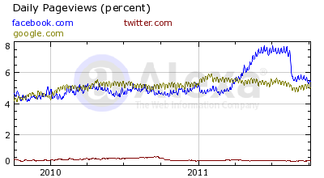
Volatility

Slide 38
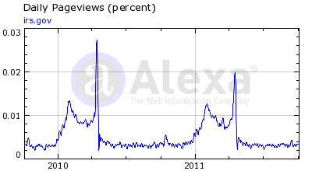
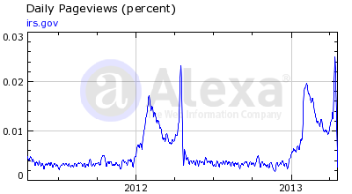

Slide 39
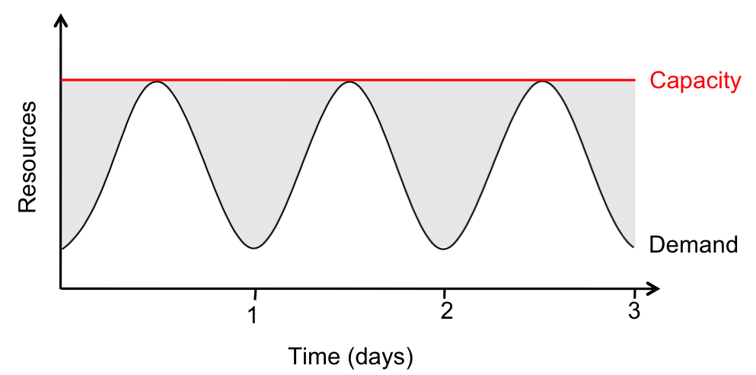
Elasticity – Provisioning for Peak
Real World Server Utilization Is 5% to 20%
Many Services Peak Exceeds Average by a Factor of 2 to 10
Most Companies Provision for Peak
It is very Painful to Under-Provision (Lost Customers)
Provisioning for Peak
Without Elasticity, We Waste Resources (shaded area) During Non-Peak Times

Slide 40
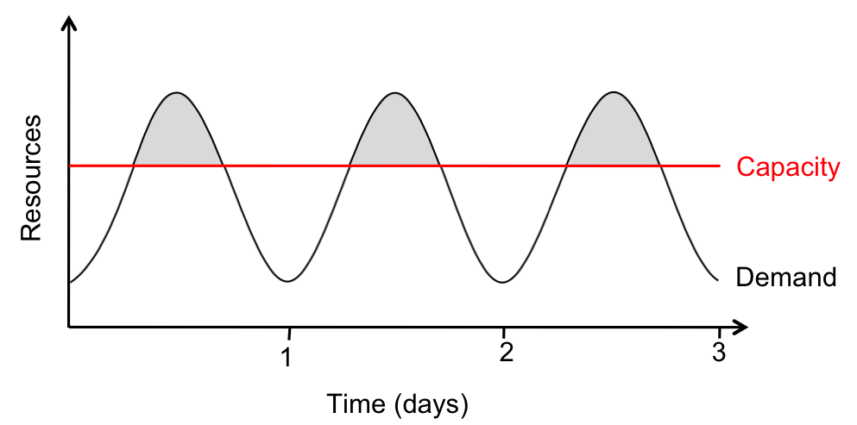
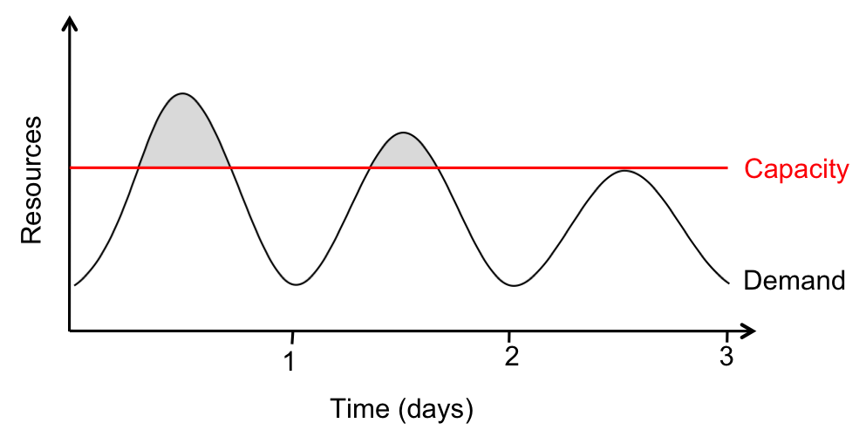
Elasticity: Risks of Under-Provisioning
Under-Provisioning #1
Potential Revenue (Shaded Area) Is Sacrificed
Under-Provisioning #2
Some Users Respond to Under-Provisioning by Permanently Deserting the Site... Bad for Revenue!

Slide 41
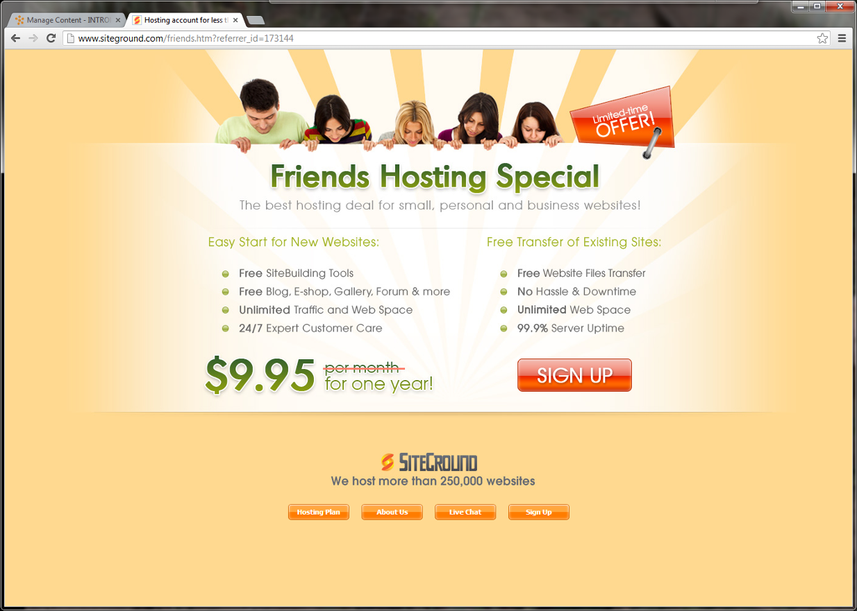
Fallback: Hosted
Renting machines, connectivity, software
Less control
Fewer responsibilities
Lower capital costs
More flexible
Pay for fixed capacity, even if idle
Notes:
The most control

Slide 42
WebHosting Contract Boilerplate
Agreement Provisions Included
Scope of Services
Price and Payment
Term and Termination
Customer Service
User's Warranties and Obligations
Ownership of Intellectual Property
Warranty and Disclaimer
Limitation of Liability
Indemnification of Host
Confidential Information
Relation of Parties
Employee Solicitation/Hiring
Non-assignment
Arbitration
Attorneys' Fees
Severability
Force Majeure
No Waiver
Entire Agreement
Exhibit A: Statement of Work
Preamble
Project Background
Scope
Key Tasks and Milestones
Project Deliverables
Time and Cost Estimates
Price and Payment
Invoices
Payment
Project Organization and Personnel Requirements
Supporting Documentation
Expenses
Exhibit B: Service Level Agreement
Downtime
Technical Support
Exhibit C: Web Hosting Acceptable Use Policy
Acceptable Use
Reporting of Violations of This Acceptable Use Policy
Revisions to This Acceptable Use Policy
http://www.contractedge.com/websitehostingagreement.html
Notes:
The contract has each of these clauses – I am not making this up
http://www.contractedge.com/websitehostingagreement.html

Slide 43

Wouldn’t it be Groovy if:

Slide 44
What If?
I pay only for WHAT I use
Only WHEN I use it
With the ability to SCALE capacity up and down on-demand

Slide 45

We just defined the
Flexibility
Speed and Agility
Choice
CLOUD MANIFESTO

Slide 46

What is Cloud Computing?
The dynamic provisioning of IT capabilities (hardware, software, or services) from third parties over a network. -Accenture
Or simply-
The practice of using a network of remote servers
…hosted on the Internet…
to store, manage, and process data - ??

Slide 47
What is Cloud Computing?
Shared, multi-tenant infrastructure
Virtualized & dynamic
Scalable & available
Abstracted from the infrastructure
Higher-level services
Pay as you go

Slide 48
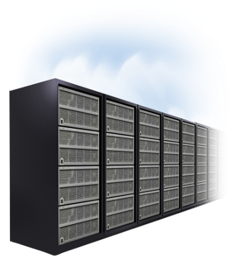
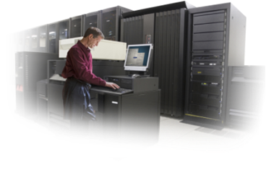
Cloud Computing
On-Premises
Cloud Services
Store Data
Run Applications
Combined with:
Utility model
Elastic Nature
*Cloud computing is a model for enabling ubiquitous, convenient, on-demand network access to a shared pool of configurable computing resources (e.g., networks, servers, storage, applications, and services) that can be rapidly provisioned and released with minimal management effort or service provider interaction -- NIST 2011
Notes:
You can use cloud computing to store your data and/or run applications on it.
The Utility model is a business model in which the provider owns, operates and manages the infrastructure and resources, and the subscribers accesses it when required, on a rental basis. Think of it as a big building with many tenants
Elastic concept in cloud computing one in which computing resources can be scaled up and down easily by the cloud service provider.
I need more “space”

Slide 49
What Is Cloud Computing?
Cloud Computing: App and Infrastructure over Internet
Compute as a Service: Applications over the Internet
Utility Computing: “Pay-as-You-Go” Datacenter Hardware and Software
Three New Aspects to Cloud Computing
The Illusion of Infinite Computing Resources Available on Demand
The Elimination of an Upfront Commitment by Cloud Users
The Ability to Pay for Use of Computing Resources on a Short-Term Basis as Needed
Notes:
1. Applications are hosted over the internet
2. Pay as you go
3. There is an illusion of unlimited computing power ---Of course at a COST!– but it is minimal comparitively!
4. No commitment
5. On-Off computing services - Short term

Slide 50
Cloud Workload Patterns
Options for applications that are ideal for the cloud

Slide 51

Workload Patterns that are Optimal for Cloud
“On and Off “
Inactivity
Period
Compute
Average
Usage
Time
On & off workloads (e.g. batch job)
Over provisioned capacity is wasted
Time to market can be cumbersome
Example: An online exam taken by students

Slide 52
Workload Patterns that are Optimal for Cloud
“Growing Fast“
Compute
Average Usage
Time
Successful services needs to grow/scale
Keeping up w/ growth is big IT challenge
Complex lead time for deployment
Example: A gaming site that gains popularity overnight

Slide 53
Workload Patterns that are Optimal for Cloud
“Unpredictable Bursting“
Compute
Average Usage
Time
Unexpected/unplanned peak in demand
Sudden spike impacts performance
Can’t over provision for extreme cases
Example: Emergency response or Utility outage reporting applications

Slide 54
Workload Patterns that are Optimal for Cloud
“Predictable Bursting“
Compute
Average Usage
Time
Services with micro seasonality trends
Peaks due to periodic increased demand
IT complexity and wasted capacity
Example: Income tax website or Retail shopping website during the holidays

Slide 55


And, what about these new scenarios?

Slide 56
Science / Research

Slide 57
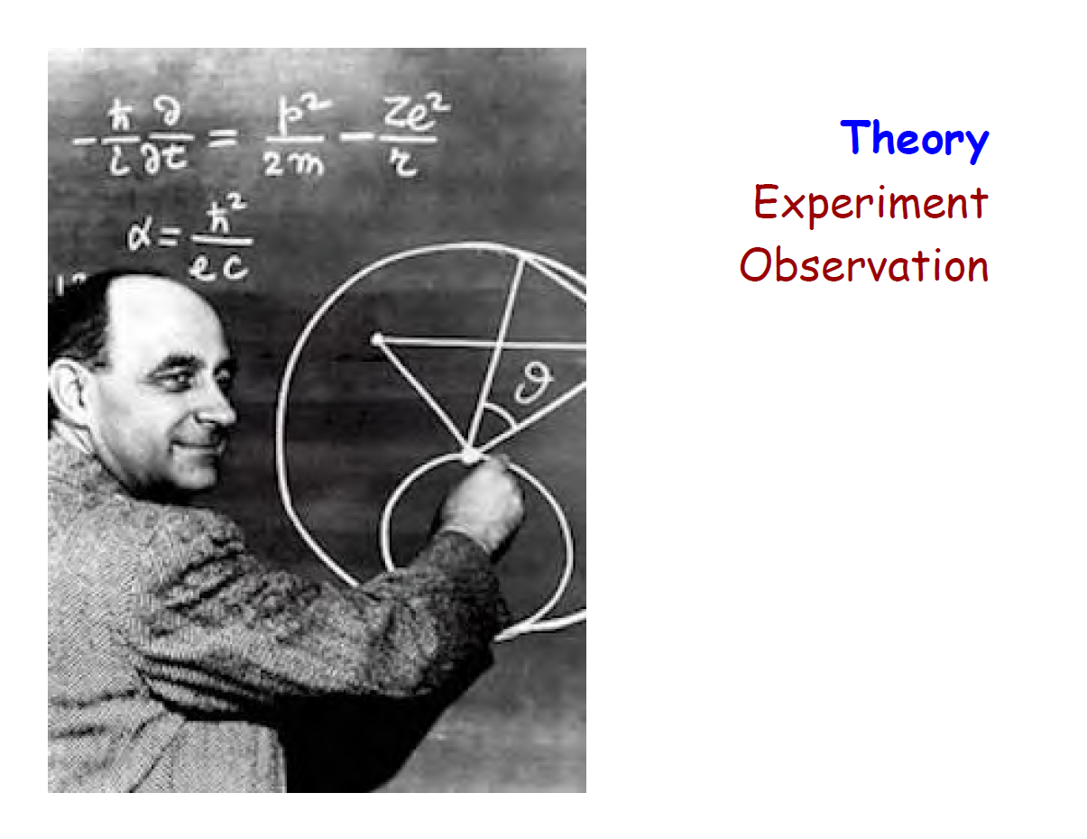

Slide 58
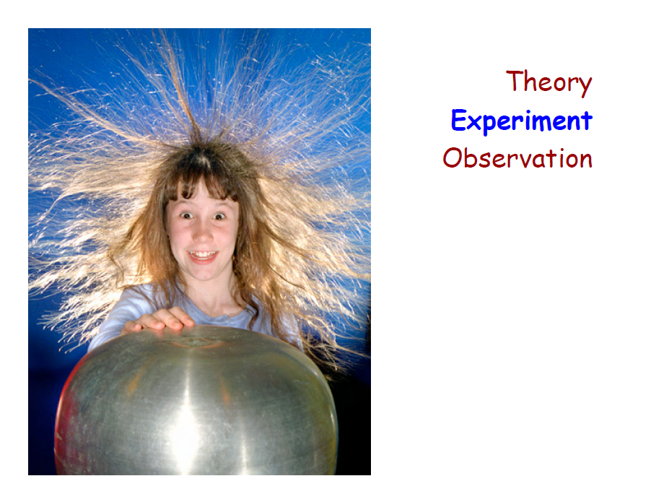

Slide 59
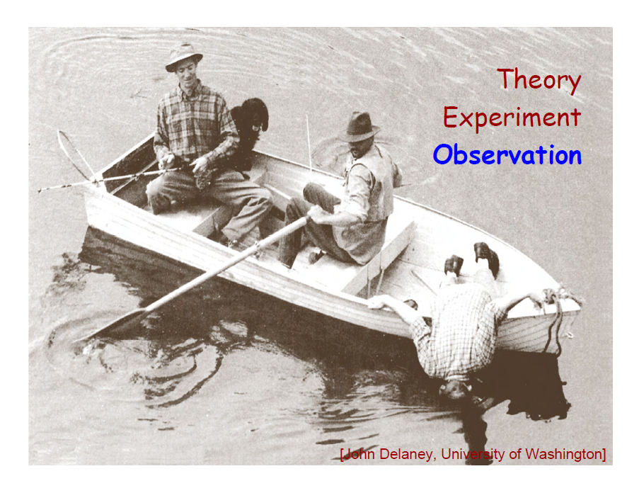

Slide 60

Theoretical computer scientists are interested in solving computational problems such as:
How do the resources needed to solve a computational problem (such as time, space, communication, and number of processors) scale with the size of the problem?
Can we distinguish "truly" random numbers from random-looking numbers generated by deterministic means? Is true randomness even necessary?
Can we build secure cryptographic protocols -- not just for exchanging secret messages, but for many other tasks needed in modern electronic commerce?
What sorts of computations can be carried out collectively by neurons in a brain, or proteins in a cell, or buyers and sellers in a marketplace?
What are the capabilities and limits of quantum computers?
Source: MIT Computer Science and Artificial Intelligence lab
http://toc.csail.mit.edu/

Slide 61
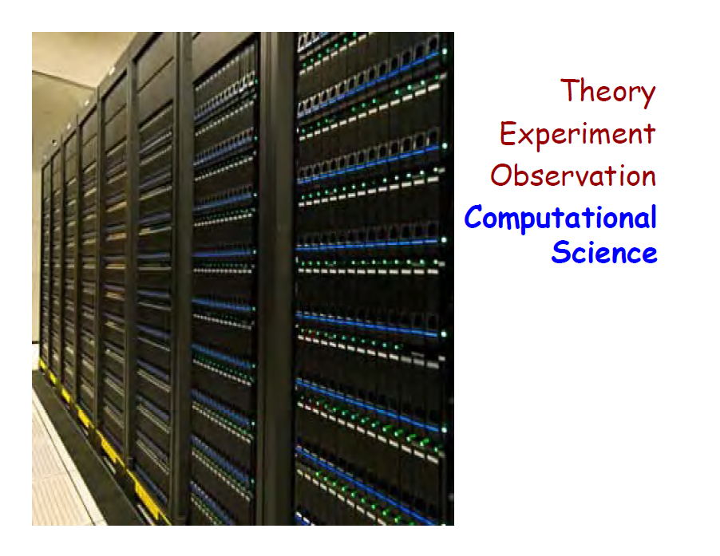

Slide 62

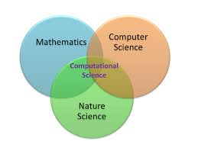
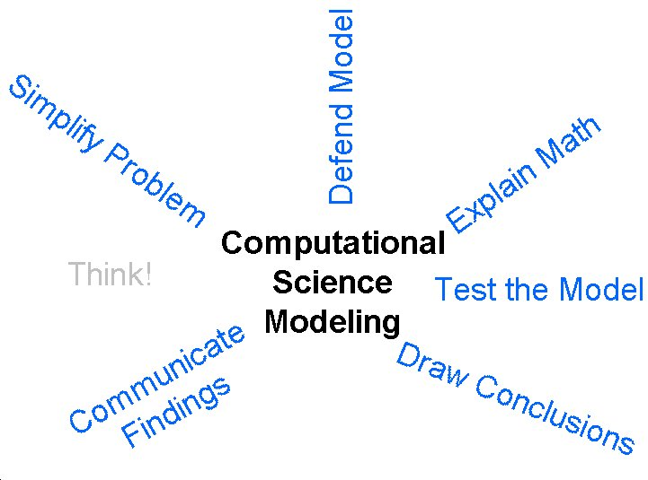
Computational science
Also called scientific computing or scientific computation is concerned with constructing mathematical models and quantitative analysis techniques and using computers to analyze and solve scientific problems.

Slide 63
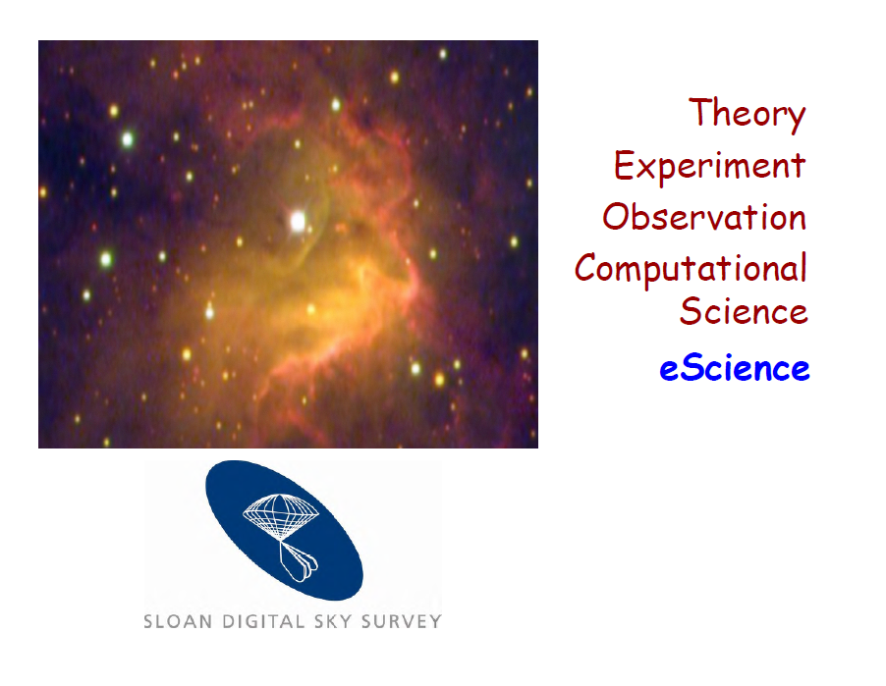

Slide 64
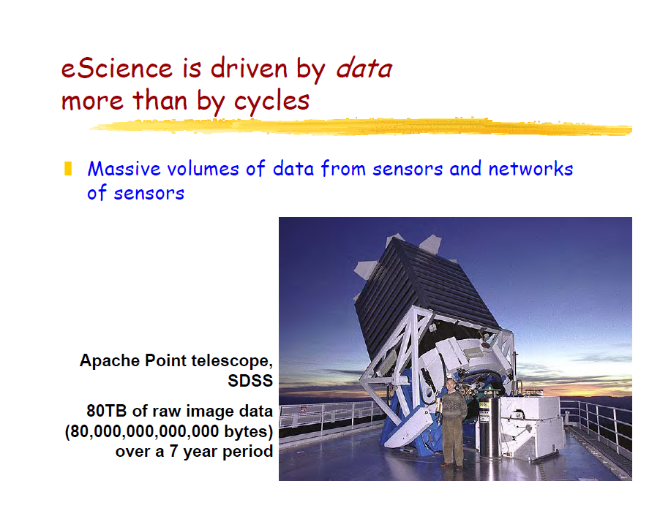
eScience is computationally intensive science that is carried out in highly distributed network environments, or science that uses immense data sets that require grid computing

Slide 65
When the Sloan Digital Sky Survey started work in 2000, its telescope in New Mexico collected more data in its first few weeks than had been amassed in the entire history of astronomy.
Now, several years later, its archive contains
140TB of information.

Slide 66
The Large Synoptic Survey Telescope, due to come on stream in Chile in 2016, will acquire that quantity of data every five days.

Slide 67
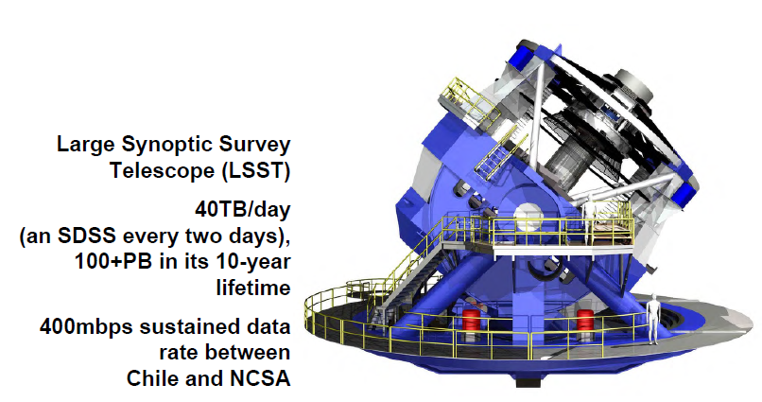
Notes:
Sloan Digital Sky Survey – 80 TB over 7 years
National Center for Supercomputing Applications

Slide 68
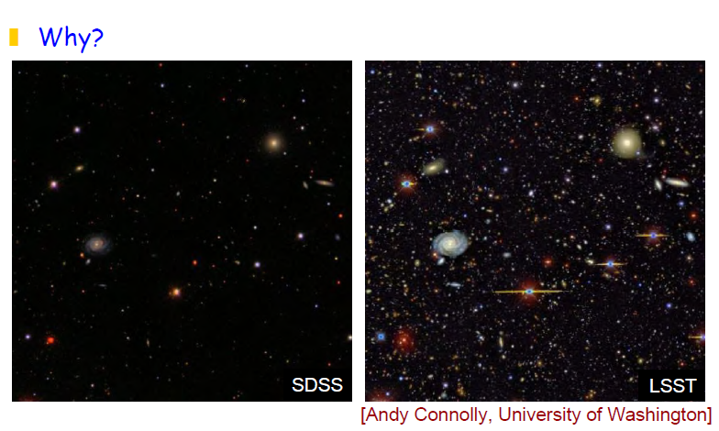

Slide 69
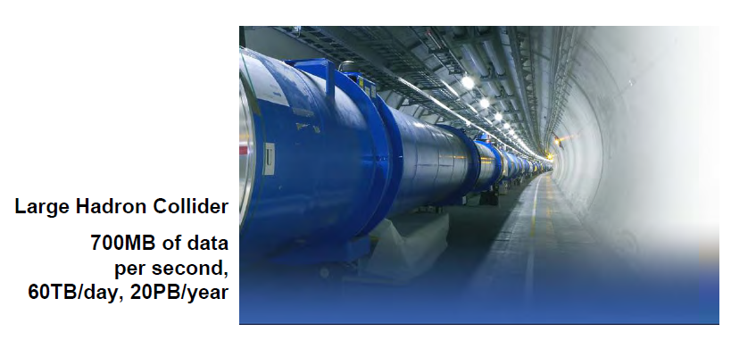

Slide 70
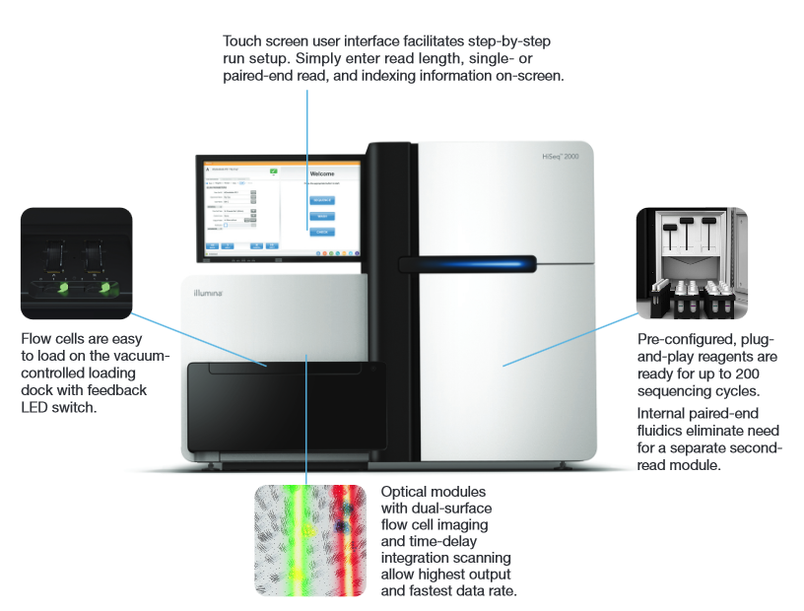
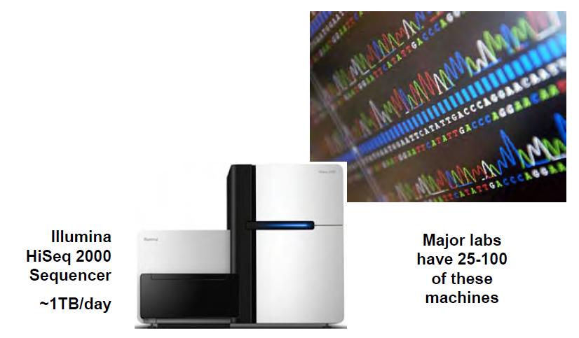

Slide 71


Slide 72

And that was 1999!

Slide 73

So, how BIG is the Internet? (December2013)
14.3 Trillion - Webpages, live on the Internet.
48 Billion - Webpages indexed by Google.Inc.
14 Billion - Webpages indexed by Microsoft's Bing.
672 Exabytes - 672,000,000,000 Gigabytes (GB) of accessible data.
43,639 Petabytes - Total World-wide Internet Traffic in the year 2013.
Over 900,000 Servers - Owned by Google.Inc, the Largest in the world.
Over 1 Yotta-byte - Total data stored on the Internet (Includes almost everything).
http://internet-map.net/

Slide 74
Business / Commerce

Slide 75
Consider these statistics:
Thirty-six months ago, at Li & Fung (Global Supply Chain Managers), 100GB of information flowed through its network each day. Now the amount has increased tenfold
In 2013 Amazon was selling $80,000 worth of stuff, every minute!
Wal-Mart, a retail giant, handles more than 1M customer transactions every hour, feeding databases estimated at more than 2.5PB — the equivalent of 167 times the books in America’s Library of Congress
Mankind created 150 exabytes (billion gigabytes) of data in 2005. In 2011 it was 1.8 zettabytes. (what is a zettabyte? 1,073,741,824 TeraBytes or 1,099,511,627,776 GigaBytes) That is every person in the US sending 4,320 tweets per day for 26,976 YEARS!

Slide 76


Internet-Scale Application
Scaling the “relational” data:
Keeps data normalized, randomly distributed, accessed at high volumes
Notes:
Source: John Rothschild, VP of Technology, Facebook

Slide 77
Internet-Scale Application
Current stats:
+500B pageviews/month
>5T feed actions/day
+800M active users
>1.5B chat mesgs/day
200M search queries/day
>6B minutes spent/day (ranked #2 on Internet)
+20B photos, +2B/month growth
600,000 photos served / sec
25TB log data / day processed thru Scribe
>900M objects interact/day
120M queries /sec on memcache
80% of Users outside US
Notes:
Source: John Rothschild, VP of Technology, Facebook

Slide 78
Cloud Application Models (IT as a Service)
Web Hosting
Massive scale infrastructure
Burst & overflow capacity
Temporary, ad-hoc sites
Application Hosting
Hybrid applications
Composite applications
Automated agents / jobs
Media Hosting & Processing
CGI rendering
Content transcoding
Media streaming
Distributed Storage
External backup and storage
High Performance Computing
Parallel & distributed processing
Massive modeling & simulation
Advanced analytics
Information Sharing
Reference data
Common data repositories
Knowledge discovery & mgmt
Collaborative Processes
Multi-enterprise integration
B2B & e-commerce
Supply chain management
Health & life sciences
Domain-specific services

Slide 79

Cloud Computing Stack
SaaS applications are designed for end-users, delivered over the web
PaaS is the set of tools and services designed to make coding and deploying those applications quick and efficient
IaaS is the hardware and software that powers it all – servers, storage, networks, operating systems

Slide 80



Cloud Services
“IaaS”
“PaaS”
“SaaS”
Infrastructure-as-a-Service
Platform-as-a-Service
Software-as-a-Service
host
build
consume

Slide 81
Cloud Services
Packaged Software
Infrastructure
(as a Service)
Platform
(as a Service)
Software
(as a Service)
Applications
Applications
You manage
Applications
Applications
Data
You manage
Data
Data
Data
Runtime
Runtime
Runtime
Runtime
Managed by vendor
You manage
Middleware
Middleware
Middleware
Middleware
Managed by vendor
O/S
O/S
O/S
O/S
Virtualization
Virtualization
Managed by vendor
Virtualization
Virtualization
Servers
Servers
Servers
Servers
Storage
Storage
Storage
Storage
Networking
Networking
Networking
Networking

Slide 82
Types of Products by Service Level
IaaS
Paas
SaaS
Amazon Web Services
Rackspace
IBM
Cisco
MS Azure
Amazon Web Services – Elastic Compute Cloud (EC2)
MS Azure
Salesforce
Cloud Foundry
Google AppEngine
Red Hat OpenShift
Force.com
Who isn’t?

Slide 83
Types of Products by Service Level
IaaS Use Cases:
Where demand is very volatile – any time there are significant spikes and troughs in terms of demand on the infrastructure
For new organizations without the capital to invest in hardware
Where the organization is growing rapidly and scaling hardware would be problematic
Where there is pressure on the organization to limit capital expenditure and to move to operating expenditure
For specific line of business, trial or temporary infrastructural needs

Slide 84
Types of Products by Service Level
IaaS is NOT good for:
Where regulatory compliance makes the offshoring or outsourcing of data storage and processing difficult
Where the highest levels of performance are required, and on-premise or dedicated hosted infrastructure has the capacity to meet the organization’s needs

Slide 85
Types of Products by Service Level
PaaS Use Cases:
PaaS is especially useful in any situation where multiple developers will be working on a development project or where other external parties need to interact with the development process. Example: sales information from a customer relationship management tool, and want to create applications which leverage that data.
PaaS is useful where developers wish to automate testing and deployment services.
PaaS can be used for Agile software development, a software development methodology based on iterative and incremental development
Some examples of PaaS include Google App Engine, Microsoft Azure Services, and Force.com.

Slide 86
Types of Products by Service Level
PaaS is NOT good for:
Where the application needs to be highly portable in terms of where it is hosted
Where proprietary languages or approaches would impact on the development process
Where a proprietary language would hinder later moves to another provider – (vendor lock-in)
Where application performance requires customization of the underlying hardware and software
*PaaS is used predominantly in software development.

Slide 87
Types of Products by Service Level
SaaS Use Cases:
“Vanilla” offerings where the solution is largely undifferentiated. Example: email - Why? → does not offer a competitive advantage
Applications that have a significant need for web or mobile access. Example: mobile sales management software
Software that is only to be used for a short term need.
Example: Collaboration software for a specific project
Software where demand spikes significantly.
Example: tax or billing software used once a month
SaaS is widely accepted to have been introduced to the business world by the Salesforce Customer Relationship Management (CRM) product.

Slide 88
Types of Products by Service Level
SaaS is NOT good for:
Applications where extremely fast processing of real time data is required
Applications where legislation or other regulation does not permit data being hosted externally
Applications where an existing on-premise solution fulfills all of the organization’s needs

Slide 89
Types of Products by Service Level (bottom line)
IaaS Use cases
Self-managed - self-provisioned, cost-effective, alternative to buying own equipment and putting into a colocation or own data center – good for test and development environs
Lightly managed - want self-managed but don’t want the headache of actually being responsible – most common scenario
Complex managed - have traditional web host needs, applications with high degree of complexity
Paas Use cases
Development environment (suite)
Run-time application platform in cloud
SaaS Use Cases
Single use
Mobile
Collaboration
Notes:
Self-managed – self-provisioned, cost-effective, alternative to buying own equipment and putting into a colocation or own data center – good for test and development environs
Lightly managed – want self-managed but don’t want the headache of actually being responsible – most common scenario
Complex -- have traditional web host needs, applications with high degree of complexity
Saas includes
Office suite providers
Customer service providers
Project management providers
Help Desk service providers
Network monitoring providers

Slide 90

Cloud Deployment models
HybridCloud image via Shutterstock

Slide 91

Public Cloud
A public cloud is one based on the standard cloud computing model, in which a service provider makes resources, such as applications and storage, available to the general public over the Internet. Public cloud services may be free or offered on a pay-per-usage model
Public clouds offer the following:
Ultimate scalability
Reliability
Flexibility
Cost effective
Location independence
Utility style costing

Slide 92

Private Cloud
Private cloud is the phrase used to describe a cloud computing platform that is implemented within the corporate firewall, under the control of the IT department.
A private cloud is designed to offer the same features and benefits of public cloud systems, but removes a number of objections to the cloud computing model including control over enterprise and customer data, worries about security, and issues connected to regulatory compliance.

Slide 93

Public cloud concerns

Slide 94

Public vs Private Cloud

Slide 95

Hybrid Cloud
A hybrid cloud is a cloud computing environment in which an organization provides and manages some resources in-house and has others provided externally. For example, an organization might use a public cloud service, such as Amazon Simple Storage Service (Amazon S3) for archived data but continue to maintain in-house storage for operational customer data.
Notes:
The hybrid approach allows a business to take advantage of the scalability and cost-effectiveness that a public cloud computing environment offers without exposing mission-critical applications and data to third-party vulnerabilities.

Slide 96

Community Cloud
A community cloud is a cloud service model that provides a cloud computing solution to a limited number of individuals or organizations that is governed, managed and secured commonly by all the participating organizations or a third party managed service provider.
Community clouds are a hybrid form of private clouds built and operated specifically for a targeted group. These communities have similar cloud requirements and their ultimate goal is to work together to achieve their business objectives.
Community clouds are often designed for businesses and organizations working on joint projects, applications, or research.

Slide 98
But, How does it work?

Slide 99
Scale-up And Scale-out
Volume
Volume
WWW
$10,000
machine
DNS
$1000
machine
$500
machine
$500
machine
$500
machine
$500
machine
$500
machine
Scale Up
Scale Out
# Machines
Notes:
Strike the right “BALANCE”
Scale-up: You can scale up by adding more processors, more memory, more storage OR buy a more robust server.
Pros
Less power consumption than running multiple servers
Cooling costs are less than scaling horizontally
Generally less challenging to implement
Less licensing costs
Cons
PRICE, PRICE, PRICE
Greater risk of hardware failure causing bigger outages
Vendor lock-in and limited upgradeability in the future
Scale-out: You can scale out by adding more servers with less processors and RAM.
Pros
Much cheaper than scaling vertically
Easier to run fault-tolerance
Easy to upgrade
Cons
More licensing fees
Bigger footprint in the Data Center
Higher utility cost (Electricity and cooling)
Possible need for more networking equipment (switches/routers)

Slide 100

The Cloud is typically a large data-center

Slide 101

Containerized Data Center Videos – Cisco Container

Slide 102
Containerized Data Center Videos- Dell Modular Approach

Slide 103
The Reality of Life In The Cloud
Business logic
…
Expand to new locale
Perform live upgrade for new feature
Apply OS patches
Service “glue”
and operations
Diagnose service failures
Add storage capacity
Handle increase in traffic
Respond to hardware failures
Datacenter
Very similar to regular data center operations isn’t it?
Notes:
Also, the traditional administration story is not that cool either.

Slide 104
What MS says we need is an
Operating System
for the Cloud
And they have one….Azure

Slide 105





High-Level Architecture
Host Partition
Guest Partition
Guest Partition
Applications
Applications
Host OS
Server Core
Guest OS
Server Enterprise
Guest OS
Server Enterprise
Virtualization Stack
(VSP)
Virtualization Stack
(VSC)
Virtualization Stack
(VSC)
Drivers
VMBUS
VMBUS
VMBUS
Hypervisor
Hardware
NIC
Disk1
Disk2
CPU
Azure

Slide 106





Windows Azure Platform Data Centers
North America Region
Europe Region
Asia Pacific Region
N. Europe
N. Central – U.S.
W. Europe
S. Central – U.S.
E. Asia
S.E. Asia
6 datacenters across 3 continents
Simply select your data center of choice when deploying an application

Slide 107


Gartner's latest Magic Quadrant for Cloud Infrastructure as a Service (IaaS) and Platform as a Service (PaaS)

Slide 108
Migrating to Cloud Issues
Bandwidth requirements go up
Security perimeters expand
Authentication requirements change
(does provider support tokens AND passwords)
Compliance can also be an issue
Virtualization requirements change

Slide 109
Other Cloud Services
Some options for cloud services

Slide 110
Shared Hosting
Shared Server – But Fully Managed
Application Competes for Resources
Memory, CPU, Bandwidth
Bundles
Email, Domain Names, Bandwidth, SiteBuilder, FTP Accounts, Console
Options
Additional Disk Space, Email Upgrades, SEO, Development tools, SSL Certificates, Shopping Carts
Inexpensive, Easy to Use, but Very Limited

Slide 111

Virtual Private Servers
Rent a shared server instance
Hardware and OS fully managed
Standard Windows, Linux OS or
Customer developed images and application stacks
Administrative access to OS functions
Some Visibility into Hardware Configurations
Control Panel Access
Some Bundles, lots of Options (AWS)
Similar Storage Approach

Slide 112
Virtual Private Servers +/-
Cost effective Utility approach
Easily Scale up or Down
Need Some Technical Expertise
Self Service Model
Good Development Environment (AWS)
However,
May Not be Best Production Environment
Typically Proprietary Virtualization Environment

Slide 113

Dedicated Servers
Physical servers, many configurations
Full administrative access to server OS
Windows or Linux OS
100% of hardware resources available
Private and custom configurations available
Network Bundles, Month to month/Annual contracts
Many Managed Services Options
Dell PowerEdge™
Best for high usage and control applications

Slide 114








Managed Hosting Services
Cisco Managed Firewall Solutions
Backup Solutions
Professional Services
Server and Device Admin
Monitoring & Reporting
Hardware Maintenance
SaaS Applications
NetDBA
Exchange, SharePoint
Software
Control Panel: Plesk, cPanel
Operating Systems
Databases
Storage Solutions
SAN, Fiber Channel, Clustering
Threat Manager - Intrusion Detection System, DDoS
Customized Load Balancing Solutions

Slide 115

Risks and Migration Issues associated with Cloud Services
Bandwidth and performance requirements go up
Vendor lock-in- Make sure there is an easy way to get the organization data out of the service if necessary
Reliability of service provider - If something goes wrong with the service provider, such as servers going down, the customer can do nothing. Choose a service provider who offers mirrored sites.

Slide 116
Risks and Migration issues associated with Cloud Services
Data security: This is not always a risk even though the security requirements of an organization do go up.
Compliance under applicable law can be an issue.
Going out of business - Where’s my data??
Notes:
Data security: The procedures and expertise of the vendor most likely will be a lot better than those of a small start-up. The issue to consider is: who gets to see your data, and what are the vendors policies for this. For example, if your data is sensitive for competitors to see. You must check vendor security policies
Compliance: For example: Does the service provider guarantee your organization’s cloud data will be stored in a data center in the United States? If not, is that acceptable to your organization? Be careful of privacy and regulatory issues
Going out of business: Investigate what would happen to the organization data, or to the application, if the service vendor is forced to shut down.

Slide 117
Memo Structure – Memo 3
Standard memo header
Standard memo body
Statement issue
Recommendation
This will be your annotated list
Give me the citation, url. Then – tell me what I will learn if I read the article. What are the strong points, what are the weaknesses. About a paragraph per article.
Background
This will be the list of repositories
There is NO required references section, since that information will be included in the annotated list.

Slide 118
Activity
In small groups I want you to come up with an outline for a disaster recovery plan for TRU
ID the threats to business operations at HQ and the data housed there,
Figure out how to mitigate the downsides.

Slide 119


Questions?

